Slide 1
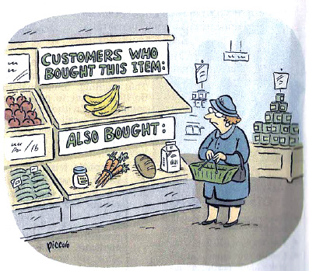
Chapter 1.1 Introduction to Recommender Systems

Slide 2
About Me
Research Interest
Recommender Systems (from 2011)
Side information enhanced recommendation
Sequential/bucket recommendation
Recommendation optimization: negative sampling (GAN), discrete optimization, de-biasing, multi-task learning
Recommendation evaluation: explanation (causal inference)
Natural Language Processing (from 2020)
Question answering (CQA, VQA, KBQA)
Knowledge graph construction & application

Slide 3
Research Projects
基于多类型用户偏好和物品属性增强的序列推荐技术研究，国家自然科学基金面上项目，61972078，项目负责人，58 万元，2020.1.1 - 2023.12.31
迁移学习在在线广告预估领域的技术研究，东北大学软件学院2021年科技奖励培育项目，项目负责人，10万元，2021.6 - 2024.6。
基于多态行为轨迹的个性化推荐技术研究，教育部项目基本科研业务费项目优秀青年科技人才培育项目，N181705007，25 万元，2019.1.1 - 2021.12.31。
PyTorch模型开发，华为昇腾众智计划项目，项目负责人，25.44万元，2021.8.1 - 2021.11.30。

Slide 4

Contact Me
Contact
http://faculty.neu.edu.cn/swc/guogb/index.html
https://guoguibing.github.io/
Email: guogb@swc.neu.edu.cn
Address: Room B436, Information Building

Slide 5
Objectives
What will you get out of this class?
Understanding a specific field of AI
Basic machine learning skills
Ideas that you could transform into a startup company or academic research

Slide 6


Textbooks
http://product.dangdang.com/26509978.html

Slide 7
Course Contents
Chapter 1: Introduction
Chapter 2: Collaborative Filtering (CF)
Similarity Measures
Matrix Factorization
Factorization Machine
Chapter 3: Content-based Recommendation
Content-based filtering
Chapter 4: Evaluation of Recommender Systems
Accuracy, explanation, serendipity
Chapter 5: Advanced Topics in CF
Sequential recommendation

Slide 8
Course Contents (2)
Sharing Link:
https://pan.baidu.com/s/1Sodfrqbh_sZswRHyobii2A
Extraction Code: zc23
Project
LibRec: https://github.com/guoguibing/librec

Slide 9
Grading
15% presence & participation
40% homework assignment 1
45% homework assignment 2

Slide 10
Why to Recommend?
Part I

Slide 11
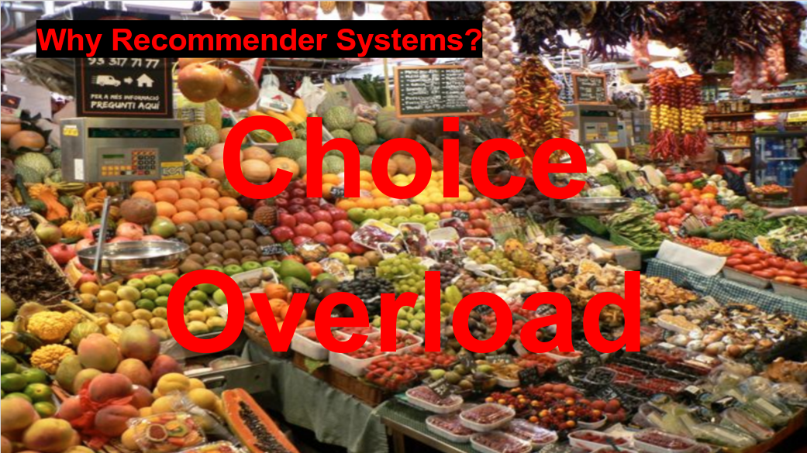
Information Overload
In a 60-second period of time, 3.3 million Facebook posts are made; 500 hours of YouTube videos are uploaded; and 150,000 emails are sent.
Internet connects everybody
Everyone can be an information generator

Slide 12
Information Overload
Information overload is when a person takes in more details than they're able to process at any given time.
Roetzel (2019) focuses on time and resources aspects. He states that when a decision-maker is given many sets of information, such as complexity, amount, and contradiction, the quality of its decision is decreased because of the individual’s limitation of scarce resources to process all the information and optimally make the best decision.
Consumer: hard to find interesting information
Provider: hard to make information available to consumers

Slide 13
Information Overload Solutions
Search Engine: search by query
Recommendation: collaborative filtering
Feed Subscription (信息流)
Chris Anderson in “The Long Tail”
“We are leaving the age of information and
entering the age of recommendation”

Slide 14
推荐系统的再理解
什么是推荐系统？
通过“协同过滤”来做“价值发现”
协同过滤是手段：大数据时代的导航仪（数据挖掘）
价值发现是核心：发现有“价值”的物品（价值发现）
辅助决策是作用：提供选项，用户决策（价值确认）
不忘“初心”、牢记“使命”
初心：过滤“低价值”物品，提升用户体验（科技向善）
使命：寻找“高价值”物品，增强价值发现的能力和水平
Notes:
从价值的层面来理解推荐，推荐要最大化的发挥它的作用，必须是满足大家的某种需求，而不仅仅只是“用户可能感兴趣的物品”

Slide 15
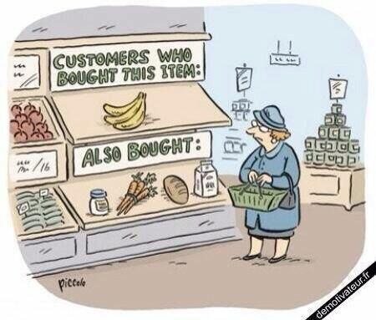
The Age of Recommendation
Search:
User Items
Recommend:
Items User
Picture from: http://insidebigdata.com/wp-content/uploads/2014/06/Humor_recommender.jpg

Slide 16


Music Recommendation

Slide 17
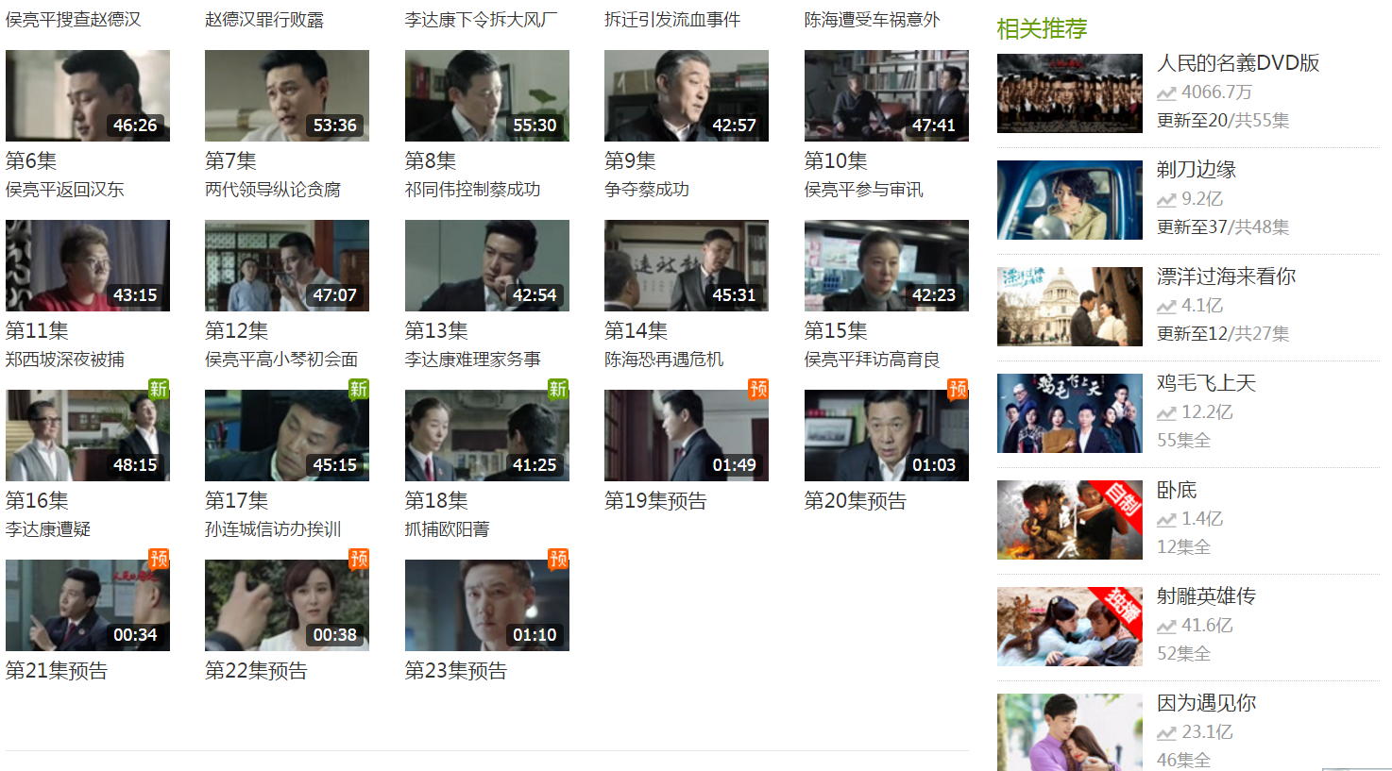
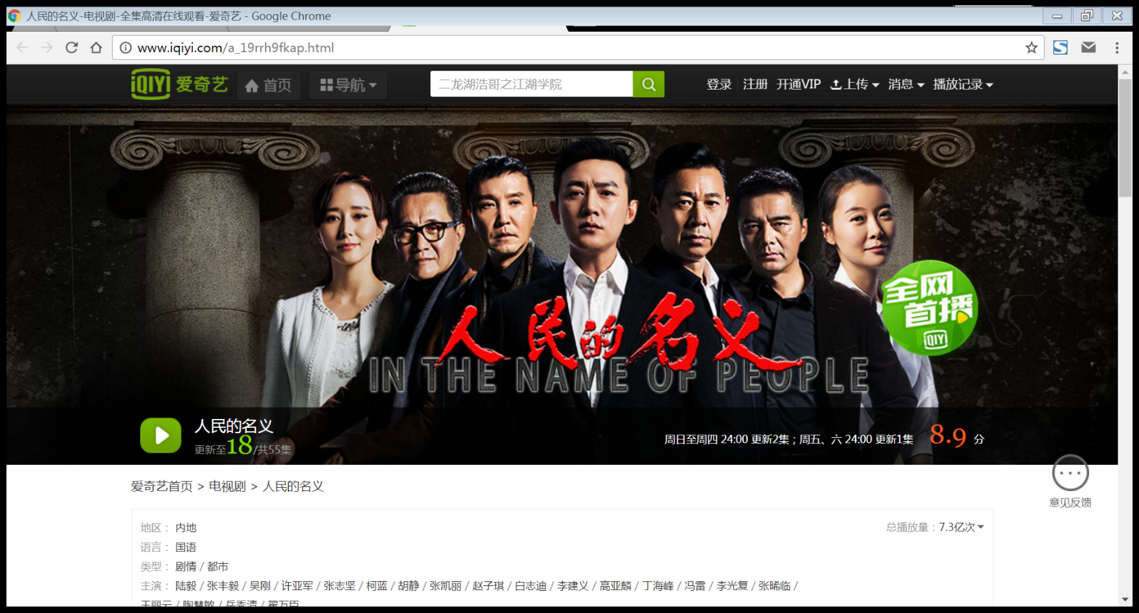
Video Recommendation

Slide 18
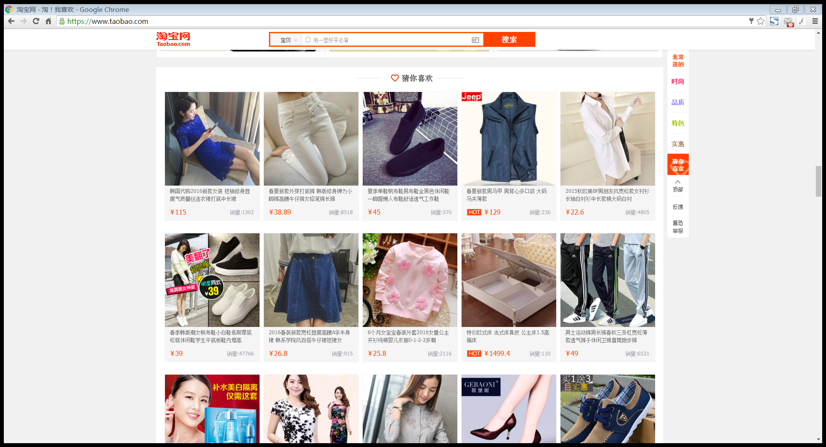
E-Commerce Recommendation

Slide 19
Query/Advertisement Recommendation

Slide 20
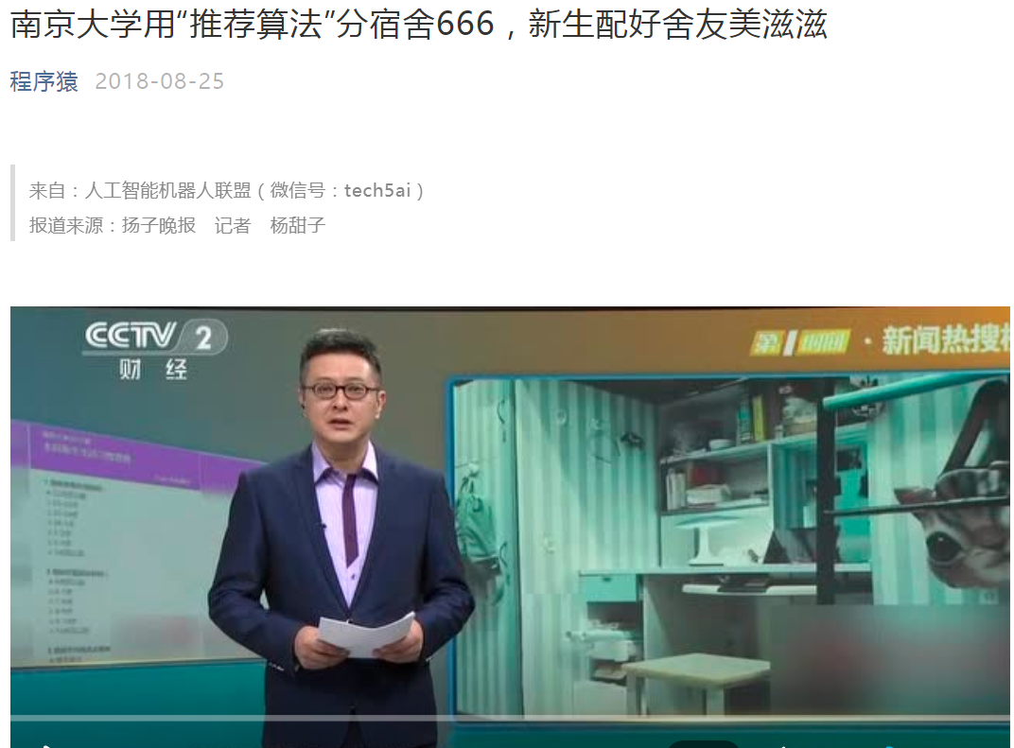
南京大学“宿舍推荐”
宿舍和谐度增加了10%!!!
Notes:
一年后的反馈调研显示，参与宿舍分配的17级新生，宿舍和谐度增加了近10个百分点。

Slide 21
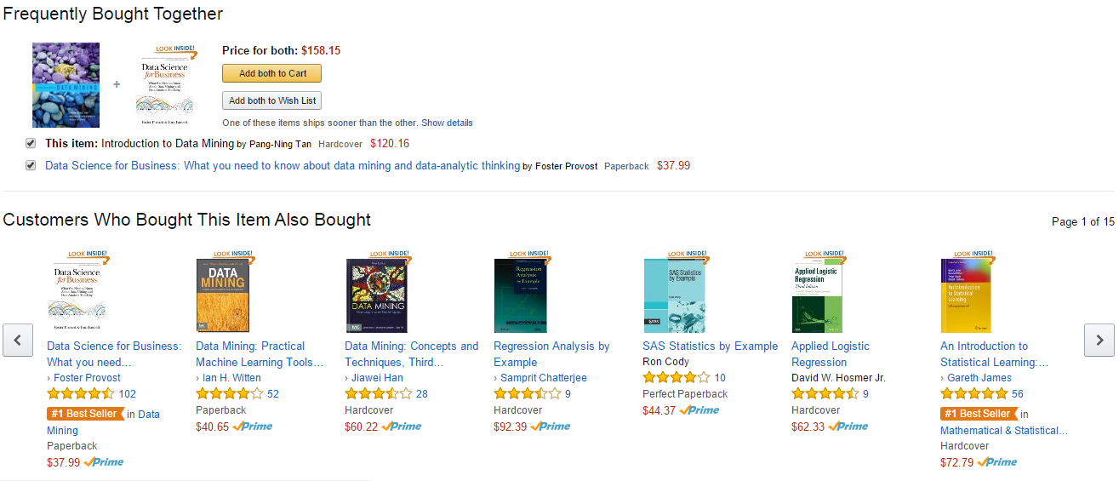
Amazon: A personalized online store

Slide 22
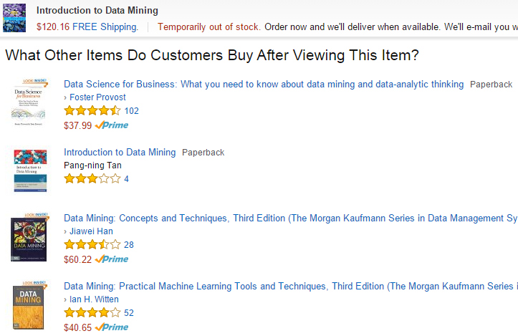
Amazon: A personalized online store

Slide 23
Useful Resources
Part II

Slide 24


MOOC Course
Recommender Systems Specialization
https://www.coursera.org/specializations/recommender-systems/
Joseph A Konstan
Professor, University of Minnesota
http://konstan.umn.edu/
Michael D. Ekstrand
Assistant professor, Boise State University
https://md.ekstrandom.net/
Notes:
LensKit

Slide 25
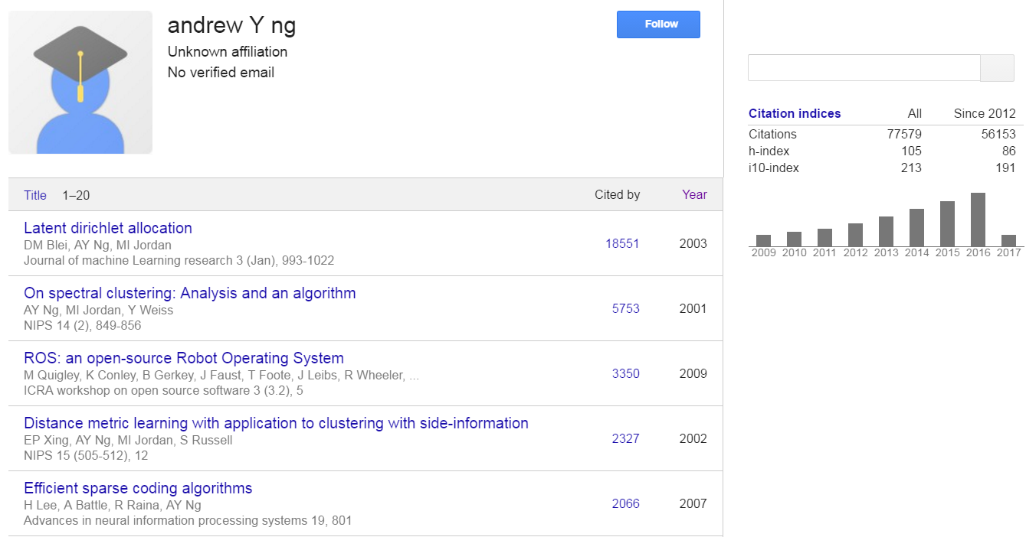
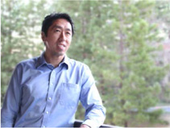
MOOC Course (2)
Machine Learning
https://www.coursera.org/learn/machine-learning
Andrew Ng (Associate Professor，Standard University)
http://www.andrewng.org/
https://www.deeplearning.ai/

Slide 26
More Resources
Conferences
RecSys, KDD, AAAI, IJCAI, ICDM, SIGIR, WSDM, CIKM, SDM
Resource collection
http://www.recsyswiki.com
https://en.wikipedia.org/wiki/Recommender_system
https://github.com/grahamjenson/list_of_recommender_systems
https://github.com/hongleizhang/RSPapers
爱派茶馆·AI脱口秀(by @爱可可-爱生活博主、北京邮电大学副教授陈光)
百闻不如一“荐”：https://www.bilibili.com/video/av18165520/?p=11
个性化与隐私： https://www.bilibili.com/video/av18165520/?p=15
https://www.ccf.org.cn/YOCSEF/Branches/Changsha/News/lt/2021-09-01/735862.shtml

Slide 27
Related Research Fields
Information Retrieval (IR)
Data Mining (DM)
Machine Learning (ML)
Human-Computer Interaction (HCI)
Artificial Intelligence (AI)

Slide 28
Recommendation as Data Mining

Slide 29
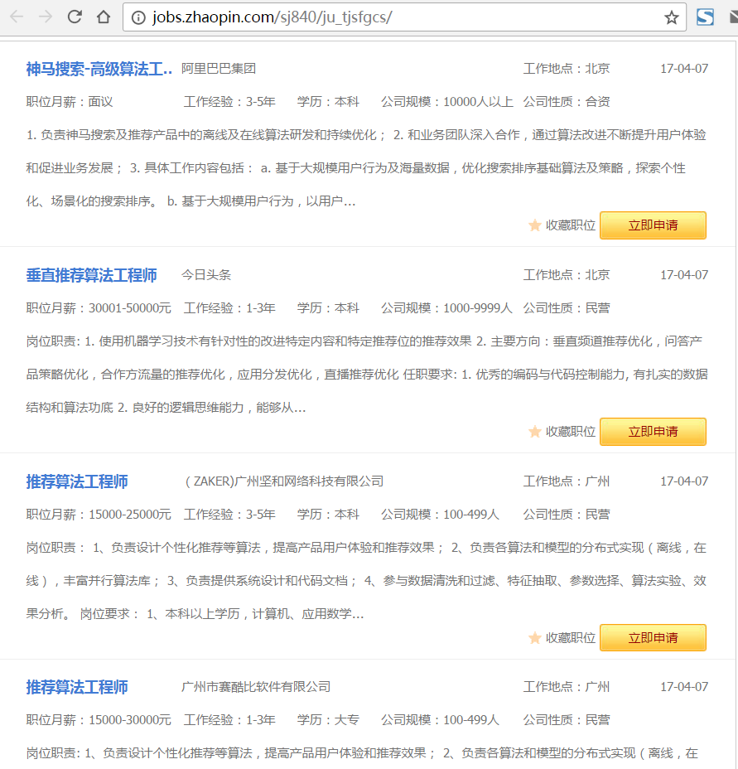
Job Positions

Slide 30
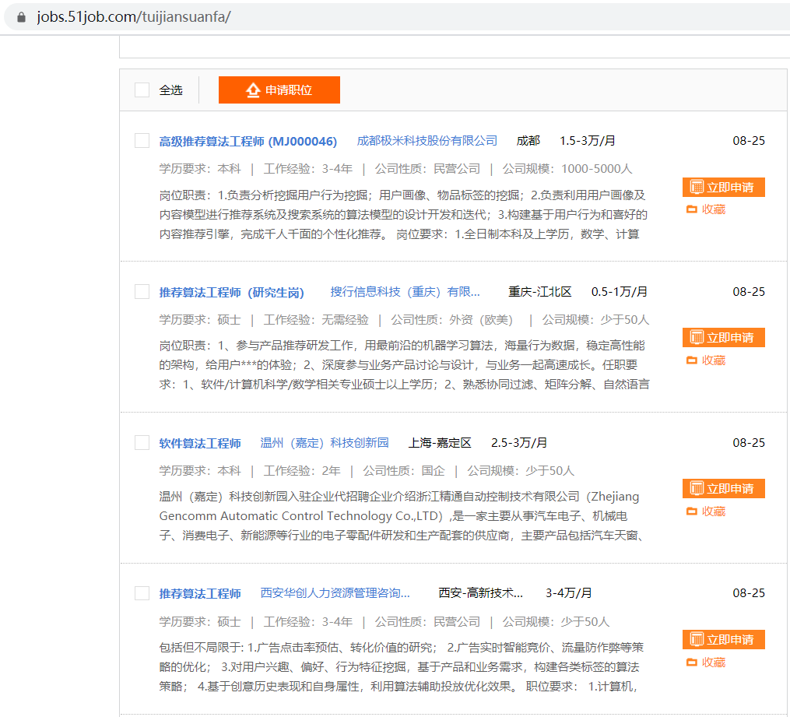
Job Positions (2)

Slide 31
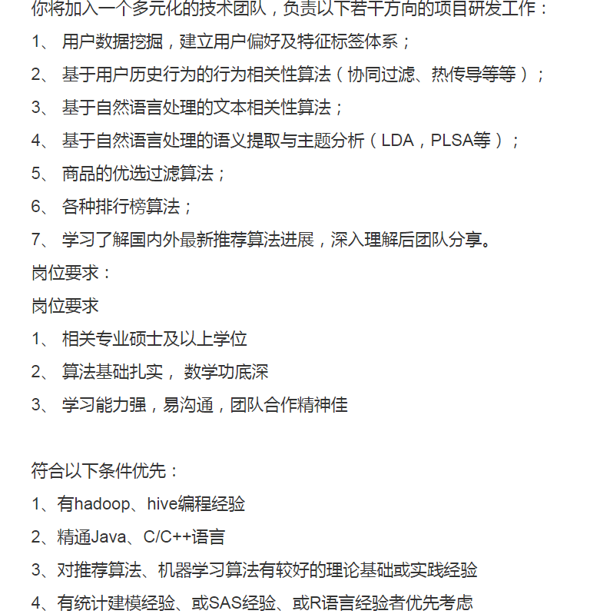
Job Requirements

Slide 32
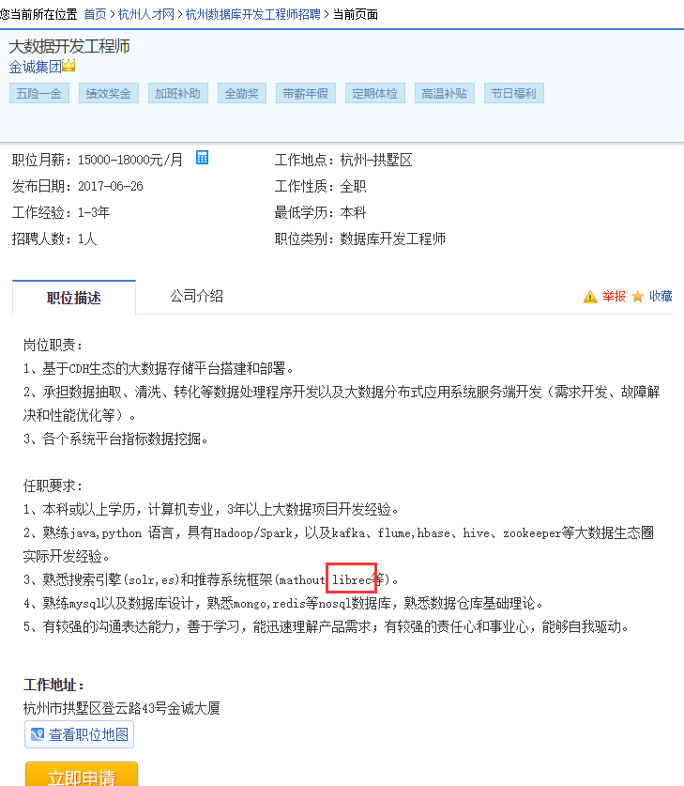
Job Requirements (2)

Slide 33
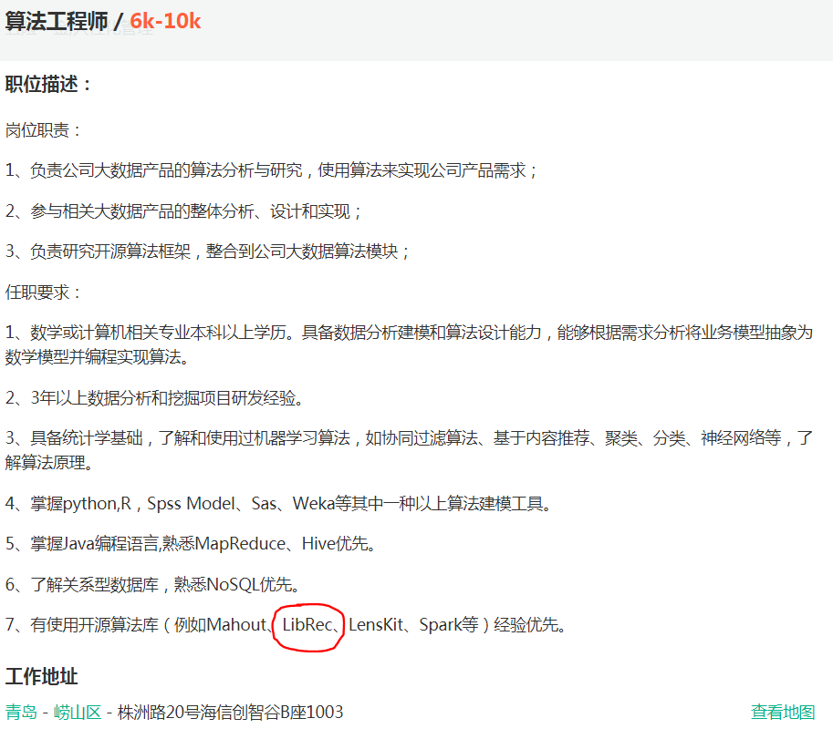
Job Requirements (3)

Slide 34
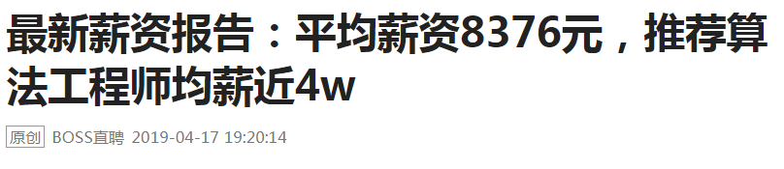
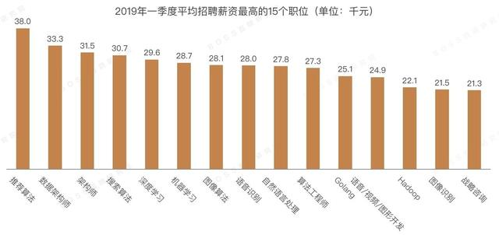
Recruitment

Slide 35
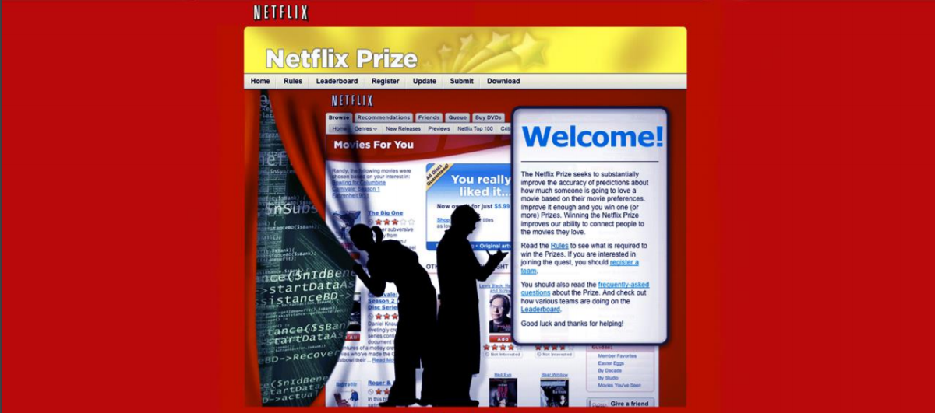
Competitions
Netflix $1,000,000 Prize Competition
2 Oct 2006 ~ 18 Sep 2009

Slide 36
What was the Netflix Prize?
In October, 2006 Netflix released a dataset containing 100 million anonymous movie ratings and challenged the data mining, machine learning, and computer science communities to develop systems that could beat the accuracy of its recommendation system, Cinematch.
Thus began the Netflix Prize, an open competition for the best collaborative filtering algorithm to predict user ratings for films, solely based on previous ratings without any other information about the users or films.

Slide 37
The Netflix Prize Datasets
Netflix provided a training dataset of 100,480,507 ratings that 480,189 users gave to 17,770 movies.
Each training rating (or instance) is of the form user, movie, data of rating, rating .
The user and movie fields are integer IDs, while ratings are from 1 to 5 (integral) stars.

Slide 38
The Netflix Prize Datasets
The qualifying dataset contained over 2,817,131 instances of the form user, movie, date of rating , with ratings known only to the jury.
A participating team’s algorithm had to predict grades on the entire qualifying set, consisting of a validation and test set.
During the competition, teams were only informed of the score for a validation or quiz set of 1,408,342 ratings.
The jury used a test set of 1,408,789 ratings to determine potential prize winners.

Slide 39
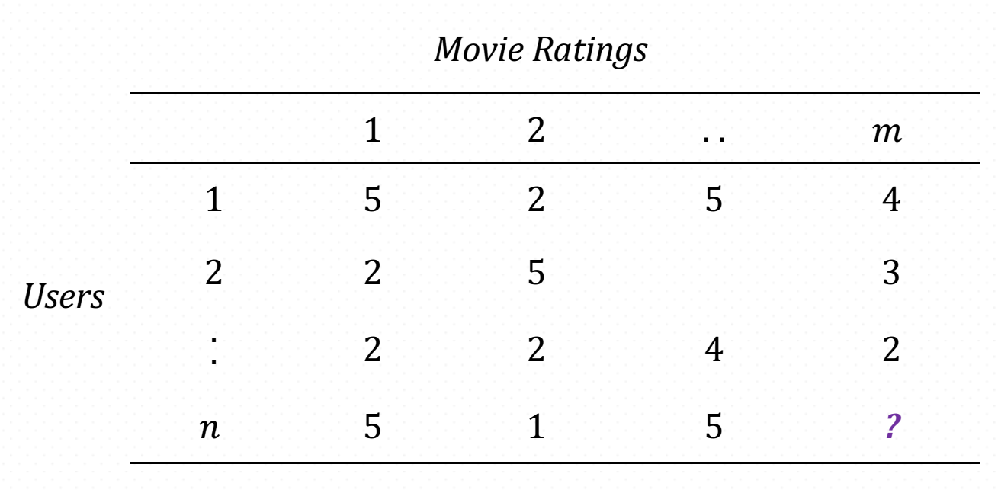
The Netflix Prize Data

Slide 40
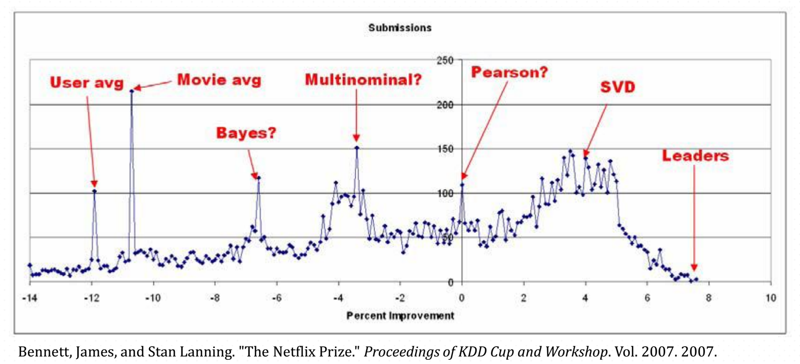
The Netflix Prize Methods

Slide 41
Competitions (2)
KDD Cup
2011: rating prediction (task 1), prediction of highly rated items (task 2) by Yahoo!
2012: VIP recommendation in Tencent Weibo (task 1) by Tencent
https://www.kaggle.com
2016: Santander Product Recommendation
2012: Job Recommendation, Music Recommendation
http://www.clef-newsreel.org/tasks/
2005-2017: News Recommendation
Dr. Frank Hopfgartner (University of Glasgow)

Slide 42
Competitions (2)
RecSys Challenge
2012: context-aware movie recommendation (task 1), scientific paper recommendation (task 2)
2013: personalized business recommendation by Yelp
2014: predict how much interaction an item would receive via Twitter (MovieTweetings datasets)
2015: e-commerce business recommendation by Yoochoose
2016: predict job postings users may interact with by XING
2017: balancing user interest and recruiter demands by XING
2018: music recommendation for automatic playlist continuation by Spotify (i.e., add new songs to the playlist or suggest a playlist)
2019: accommodation recommendation by trivago (travel advisor)
2020: tweet engagement prediction (like, reply, retweet, comment)
2021: tweet engagement prediction (accuracy and fairness)
https://recsys.acm.org/

Slide 43
Competitions (3)
天池大数据竞赛
Repeat Buyers Prediction
Coupon Usage Prediction in Daily Life
Sina Weibo Interaction Prediction
Clothes Matching Challenge on Taobao.com
https://tianchi.aliyun.com/competition/gameList.htm
腾讯社交广告-高校算法大赛
http://algo.tpai.qq.com , to predict if an ad will be activated after clicking
http://www.datafountain.cn
高潜用户购买意向预测 （Jdata算法大赛)
基于历史数据的智能高考志愿填报推荐系统
唯品会用户购买行为预测
https://www.tinymind.cn/competitions/ai

Slide 44
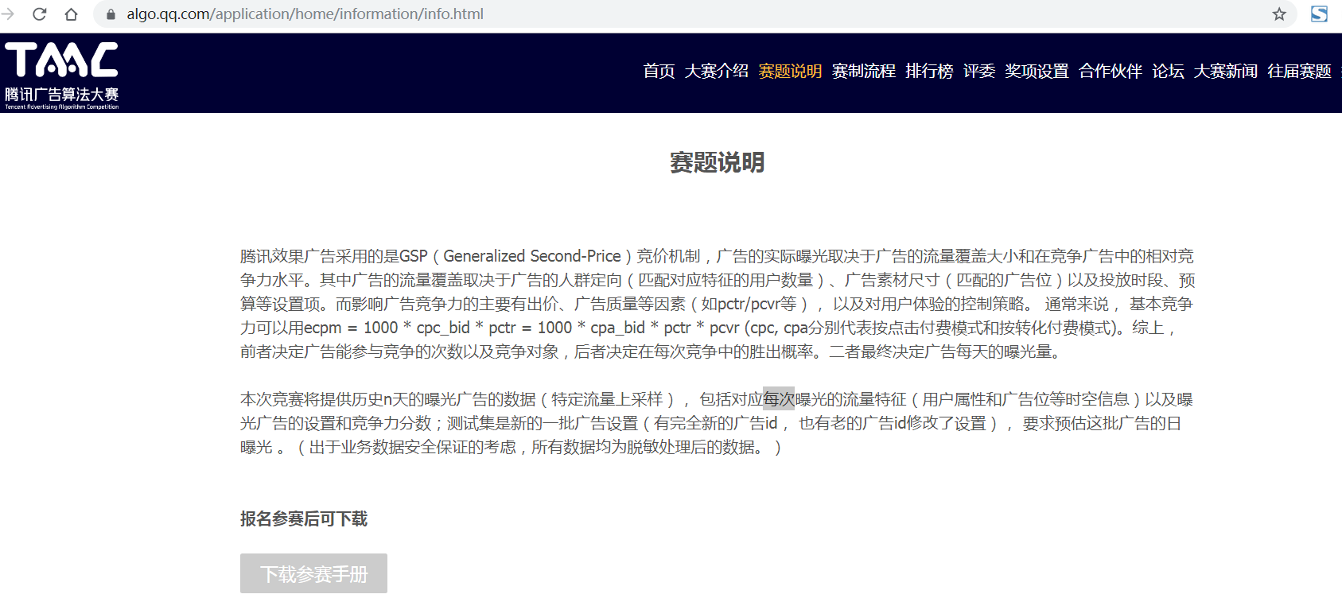
腾讯广告算法大赛
http://algo.qq.com

Slide 45
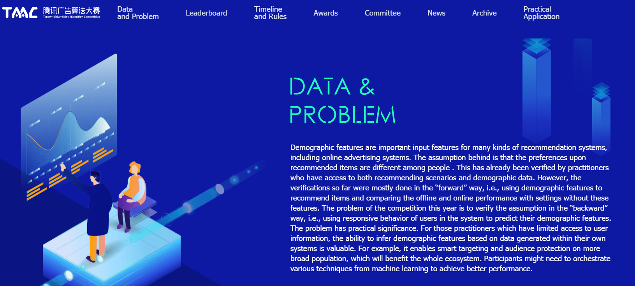
腾讯广告算法大赛2020
The problem of the competition this year is to verify the assumption in the “backward” way, i.e., using responsive behavior of users in the system to predict their demographic features

Slide 46
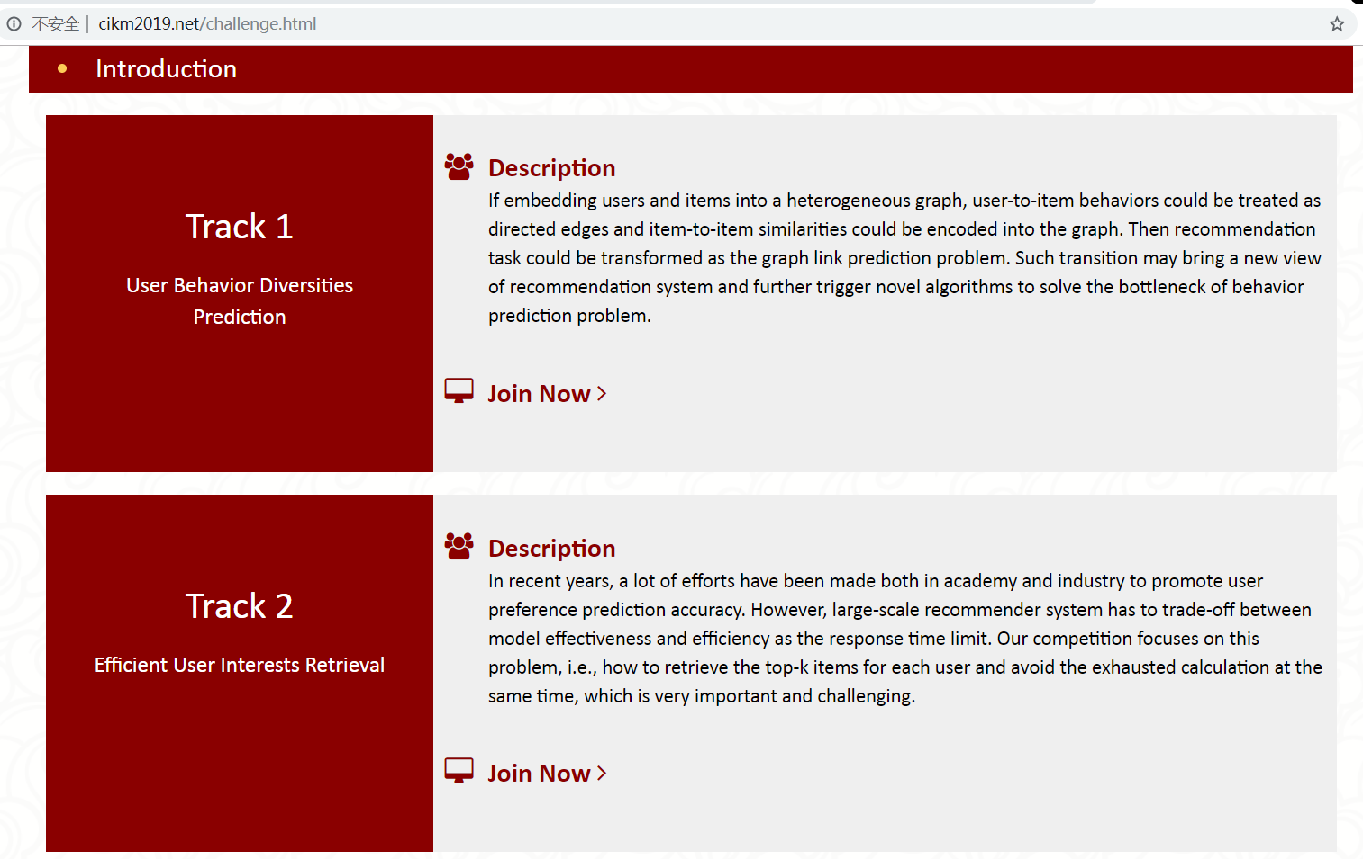
CIKM 2019 Alibaba E-Commerce AI Challenge

Slide 47
Paradigms of Recommender Systems
Part III

Slide 48
Outline
(1) Problem definition
(2) Purpose and success criteria
(3) Paradigms of recommender systems
Collaborative filtering
Content-based filtering
Knowledge-based recommendations
Hybridization strategies

Slide 49
Recommender Systems
Recommender systems (RS) help to match user with items
Ease information overload
Satisfy user needs for personalization
RS are software agents that elicit the interests and preferences of individual consumers […] and make recommendations accordingly.
They have the potential to support and improve the quality of the decisions consumers make while searching for and selecting products online.
>> (Xiao & Benbasat 2007¹)
1. Xiao and Benbasat, E-commerce product recommendation agents: Use, characteristics, and impact, MIS Quarterly 31 (2007), no. 1, 137–209

Slide 50
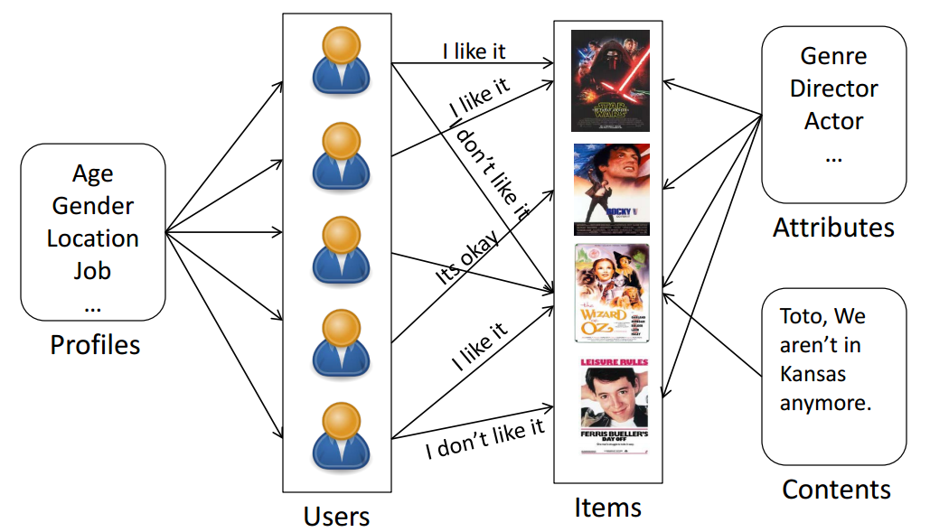
Recommender Systems Architecture
Lu, Medo, Yeung, Zhang, Zhang, Zho (2012). Recommender systems, Physics Reports 519 (2012), pg. 9

Slide 51
Recommendation Examples
Facebook — “People You May Know”
Netflix — “Other Movies You May Enjoy”
LinkedIn — “Jobs You May Be Interested In”
Amazon — “Customer who bought this item also bought …”
Google — “Visually Similar Images”
YouTube — “Recommended Videos”
Waze — “Best Route”

Slide 52
What to recommend
E-commerce product
Advertisement
Multimedia: image/video/music/audio/radio/TV
Text: tag, paper, news, webpages, book
Question in Q/A system
Location in POI-based systems, travelling
A package of different items
People: followee, online dating
Notes:
More: task recommendation in crowdsourcing systems

Slide 53
Whom to recommend
A single user
A group of users:
E.g., family, class students, etc.
Reciprocal recommendation,
E.g., dating, job hunting, etc.

Slide 54

When does a RS do its job well?

Slide 55
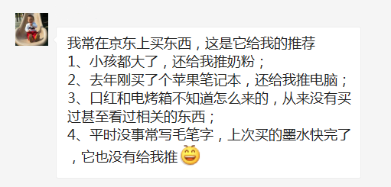
When does a RS do its job well?

Slide 56
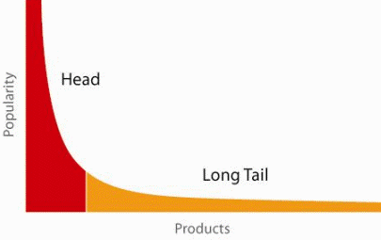
When does a RS do its job well?
"Recommend widely unknown items that users might actually like!"
20% of items accumulate 74% of all positive ratings
Items rated > 3 in MovieLens 100K dataset
Recommend items from the long tail

Slide 57
Potential Value of Recommendation
For providers:
Change user behavior in desired directions
Create additional demand
Increase (short term) business success
Enable item “discoverability”
Increase activity on the site and user engagement
Provide a valuable add‐on service
Learn more about the customers

Slide 58
Recommendation Value
Notes:
ChoiceStream: 28% of the people would buy more music if they found what they liked.
Amazon: 30%的页面浏览来自于推荐系统。Source: A. Sharma, J.M. Hofman, D.J. Watts, “Estimating the Causal Impact of Recommendation Systems from Observational Data,” Proc. 16th ACM Conf. Economics and Computation, 2015, pp. 453–470.
Netflix: 80%以上的电影观看来自于推荐系统。Source: C.A. Gomez-Uribe and N. Hunt, “The Netflix Recommender System: Algorithms, #Business |Value, and Innovation,” ACM Trans. Management Information Systems, vol. 6, no. 4, 2016, pp. 1–19.
Taobao: recommendation contributes 80% and 50% to the revenues and traffic in Taobao. Source: Wang et al., “Billion-scale Commodity Embedding for E-commerce Recommendation in Alibaba”, KDD 2018.
Google News: recommendation generates 38% more click-throughs

Slide 59
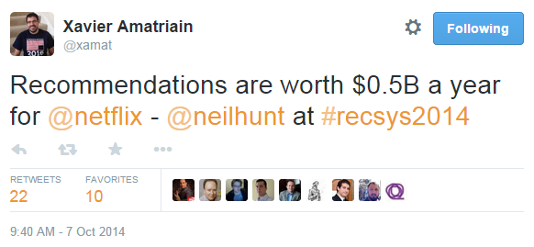
Recommendation Value (2)
Taobao: 158 billion (Alibaba) * 75% (from Taobao) * 80% (Rec)
= 94.8 billion (in 2017)
Notes:
Taobao has 1 billion users and 2 billion items.

Slide 60
Recommendation Value (3)
Panaqiotis & Alexander (2015)²
“10% recommendations increase lead to 6.7% product demand increase”
2. Panaqiotis and Alexander, The Business Value of Recommendations: A Privacy-Preserving Econometric Analysis, ICIS 2015.

Slide 61
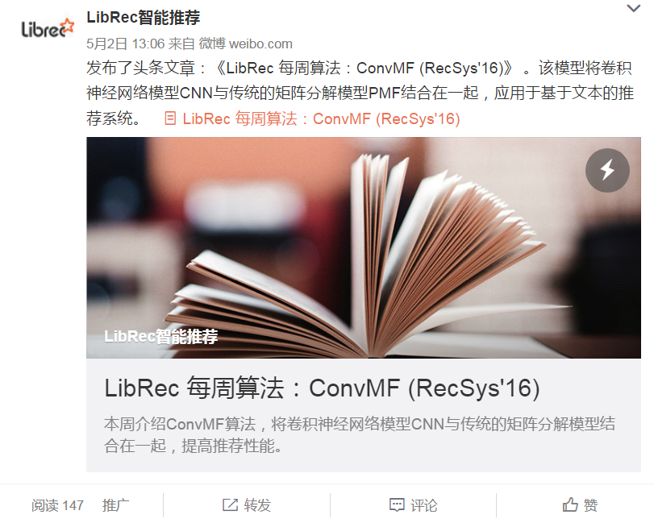
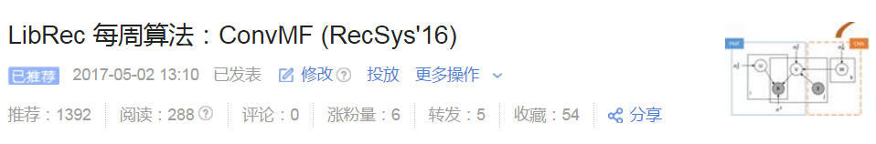
Recommendation Value (4)
Weibo fans: 276
Toutiao fans: 0
Baseline:
345 reads in WeChat
with 1304 sendings, labeled
as favors by 7 users

Slide 62
课堂思辨：我们需要什么样的推荐系统？
你遇到什么样的奇葩推荐？
你认为什么才是好的推荐？
你觉得未来的推荐系统应该是什么样的？

Slide 63
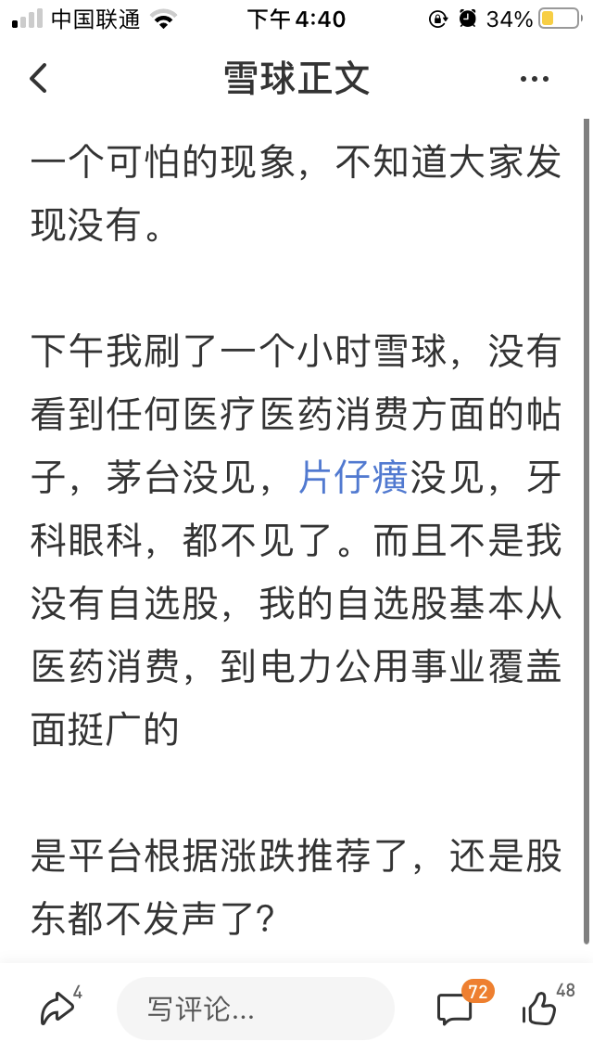
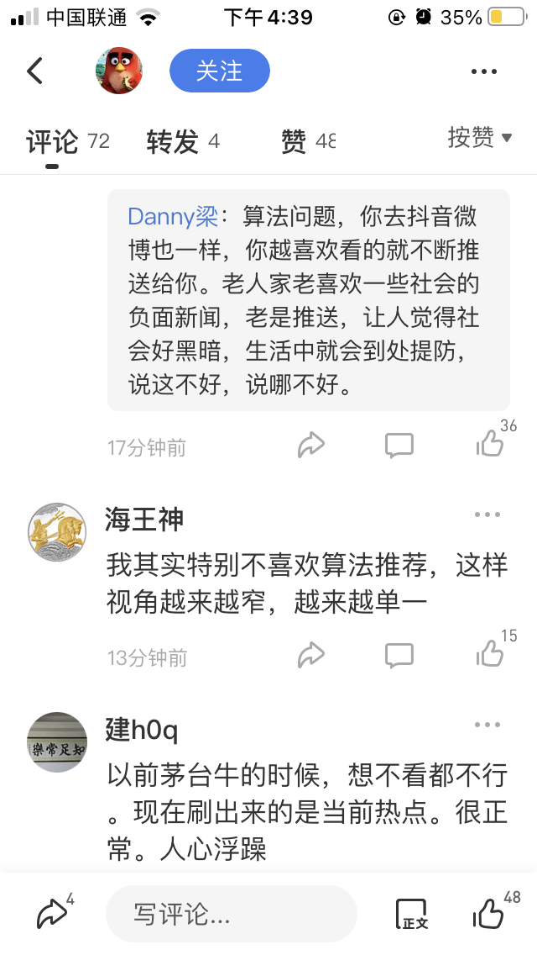
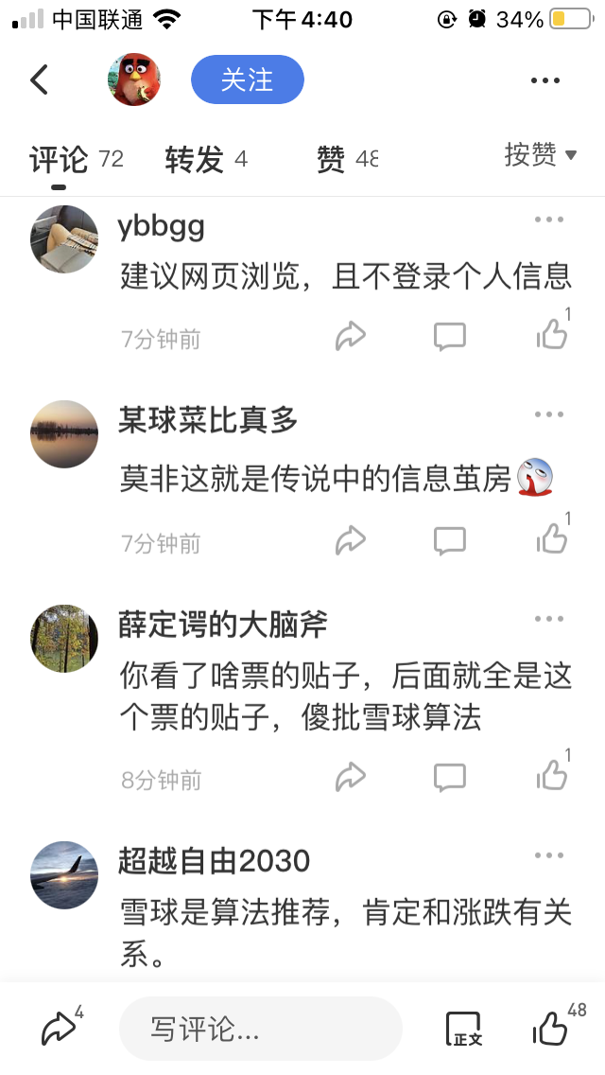
推荐系统的现有问题
“逃离推荐算法”

Slide 64
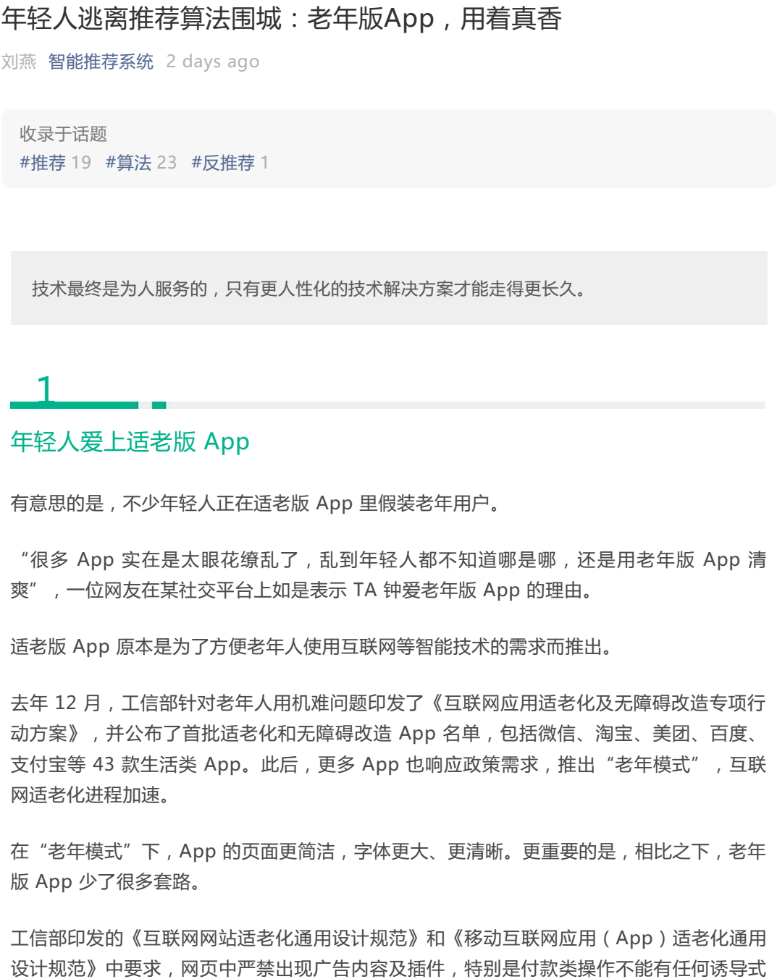
推荐系统的现有问题
“逃离推荐算法”

Slide 65
Potential Value of Recommendation (2)
For users:
Help users find objects that match their long‐term preferences (information filtering)
Help users explore the item space and improve decision making
Make contextual recommendations, e.g.,
Show alternatives
Show accessories
Remind users of what they liked in the past
Actively notify consumers of relevant content
Influence others, help others

Slide 66
Potential Value of Recommendation (3)
Multi‐stakeholder considerations:
When goals are fully aligned
Better recommendations can lead to more satisfied, returning customers who find what they need
This is one implicit assumption of academic research
When there can be a goal conflict
Not all recommendable items may have the same business value
From a business perspective, it might be better to recommend items with a higher sales margin, as long as the recommendations are still reasonable

Slide 67
Potential Value of Recommendation (4)
Multi‐stakeholder considerations:
An even more complex example
Consider a hotel booking site, where hotels pay commissions when they are booked through the site
Potential goals for the stakeholders
Consumer：Find a hotel that matches the needs and represents the best value for money (2 goals already)
Booking site：Help users find a matching deal, also maximize commission
Hotel：Maximize revenue and/or maximize occupancy rate

Slide 68
Recommendation Problem
RS seen as a function:
to estimate a utility function that automatically predicts how (and to what extent) a user will like an item.
Given:
User profile (e.g., ratings, preferences, demographics)
Item profile (e.g., description, content)
Search:
Relevance score for ranking

Slide 69
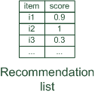

Paradigms of recommender systems
Recommender systems reduce information overload by estimating relevance

Slide 70


Paradigms of recommender systems
Personalized recommendations

Slide 71

Paradigms of recommender systems
Collaborative: "Tell me what's popular among my peers"

Slide 72

Paradigms of recommender systems
Content-based: "Show me more of the same what I've liked"

Slide 73

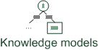
Paradigms of recommender systems
Knowledge-based: "Tell me what fits based on my needs"

Slide 74
Paradigms of recommender systems
Hybrid: combinations of various inputs and/or composition of different mechanism

Slide 75


Recommender systems: basic techniques
 | Pros | Cons
Collaborative | No knowledge-engineering effort, serendipity of results, learns market segments | Requires some form of rating feedback, cold start for new users and new items
Content-based | No community required, comparison between items possible | Content descriptions necessary, cold start for new users, no surprises
Hybrid | Better performance | Hard to implement; high complexity

Slide 76
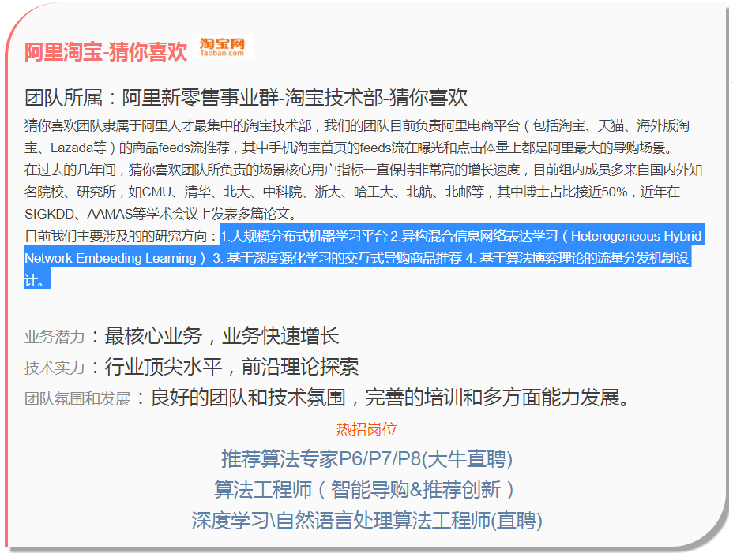
推荐算法团队

Slide 77
Toolkits & Implementation
Part IV

Slide 78
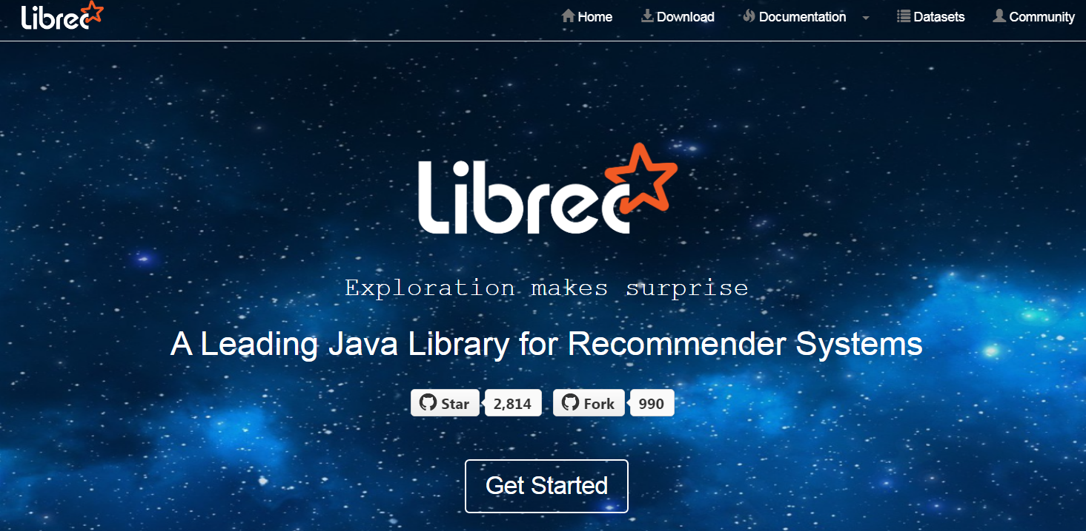
LibRec
https://github.com/guoguibing/librec

Slide 79
LibRec History
LibRec 1.0-1.4_alpha (for research)
Just for research experimentations
Arising due to OS constraint: CentOS
LibRec 2.0 (teamwork)
Consists of over 70 algorithms
LibRec 3.0 (ready for academia)
More than 90 algorithms
More efficient structures and flows
LibRec 4.0 (develop for industry)
Application in real industry cases

Slide 80

LibRec (Cont’d)
LibRec Team
8 Ph.D (3/8 overseas)
3 Master, 3 Industry
WeChat Platform
aiLibRec (5500+)

Slide 81
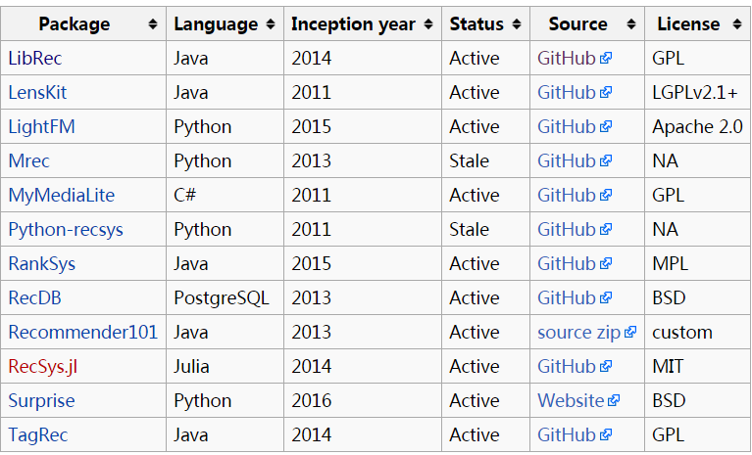
Recommendation Software
表格来源于：http://www.recsyswiki.com/wiki/Recommendation_Software

Slide 82
Recommendation Softwares
Package | Language | Inception year | Status | Source | Star | Fork | License
LibRec | Java | 2014 | Active | GitHub | 1206 | 508 | GPL
LensKit | Java | 2011 | Active | GitHub | 666 | 269 | LGPLv2.1+
LightFM | Python | 2015 | Active | GitHub | 1380 | 238 | Apache 2.0
Mrec | Python | 2013 | Stale | GitHub | 391 | 115 | NA
MyMediaLite | C# | 2011 | Active | GitHub | 380 | 167 | GPL
Python-recsys | Python | 2011 | Stale | GitHub | 959 | 381 | NA
RankSys | Java | 2015 | Active | GitHub | 169 | 42 | MPL
RecDB | PostgreSQL | 2013 | Active | GitHub | 184 | 38 | BSD
Recommender101 | Java | 2013 | Active | source zip |  |  | custom
RecSys.jl | Julia | 2014 | Active | GitHub | 23 | 11 | MIT
Surprise | Python | 2016 | Active | Website | 1052 | 206 | BSD
TagRec | Java | 2014 | Active | GitHub | 68 | 21 | GPL
Updated at 2017-12-19

Slide 83
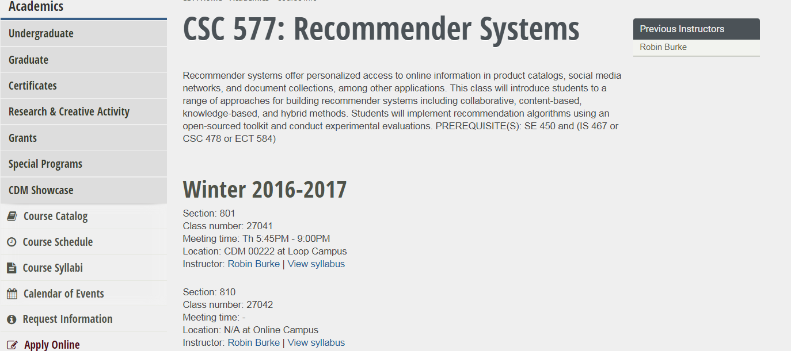
LibRec in Courses
CSC 577: Recommender Systems (2017)
Prof. Robin Burke, DePaul University, US
Semantic Web (2015)
Asso. Prof. Weike Pan, Shenzhen University, CN
https://sites.google.com/site/weikep/recommendation

Slide 84
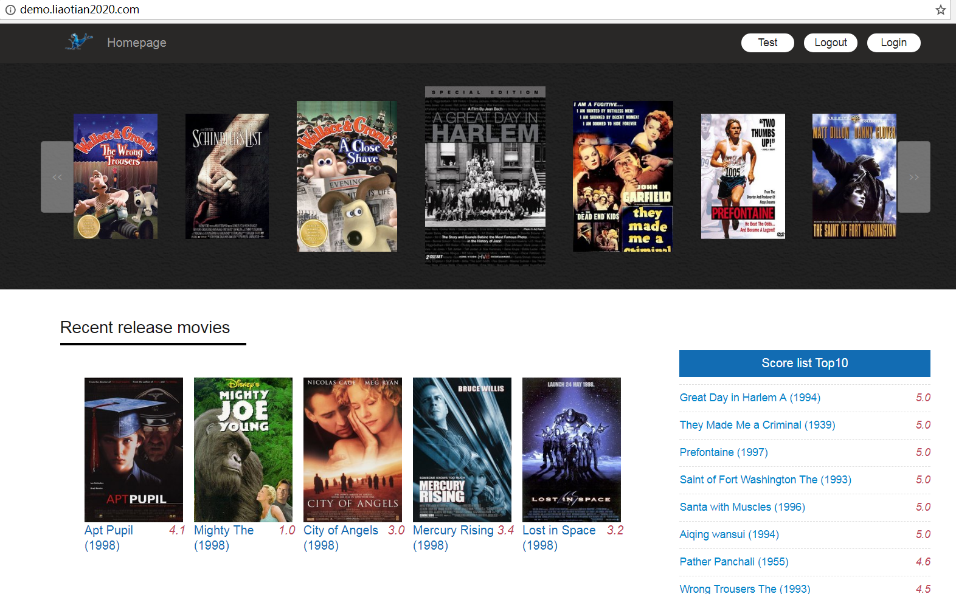
LibRec Demo
by 张建斌（就职于中清龙图，源码： https://github.com/395299296/librec-to-movies ）

Slide 85
Research Vision
Part V

Slide 86
Recommendation Research
Side information enhanced recommendations
Social relationships
Item metadata (knowledge graph)
Auxiliary implicit feedback
Heterogeneous information sources: text, image, audio, video, tags, timestamps, etc…
New recommendation paradigms
Deep learning for recommender systems
End-to-end deep neural networks: Deep autoencoders, NCF, ..
DL-enhanced model-based approaches: ConvMF, CDL, ..
Transfer/ensemble learning for recommendations
Cross-domain recommendations

Slide 87
Why deep learning has potential for RecSys?
Feature extraction directly from the content
Image, text, audio, etc.
Instead of metadata
For hybrid algorithms
Heterogenous data handled easily
Dynamic behavior modeling with RNNs
More accurate representation learning of users and items
Natural extension of CF and more
RecSys is a complex domain
Deep learning worked well in other complex domains
Worth a try

Slide 88
The deep learning era of RecSys
Brief history
2007: Deep Boltzmann Machines for rating prediction
Also: Asymmetric MF formulated as a neural network (NSVD1)
2007-2014: calm before the storm
Very few, but important papers in this topic
2015: first signs of a deep learning boom
Few seminal papers laying the groundwork for current research directions
2016: steep increase
DLRS workshop series
Deep learning papers at RecSys, KDD, SIGIR, etc.
Distinct research directions are formed by the end of the year
2017: continuation of the increase of DL in recommenders

Slide 89
Deep Learning for RecSys
DL (DNN, AE, CNN, RNN) boosts recommendation performance.
CNNs ideal for content-based feature learning: ameliorate cold-start problem
RNNs very powerful for sequence based recommendation, multi-modal learning, and order-aware distributed representation, trends forecast ...
New topics?
Personalized content generation: news articles, art, movies, songs, design, fashion, …

Slide 90
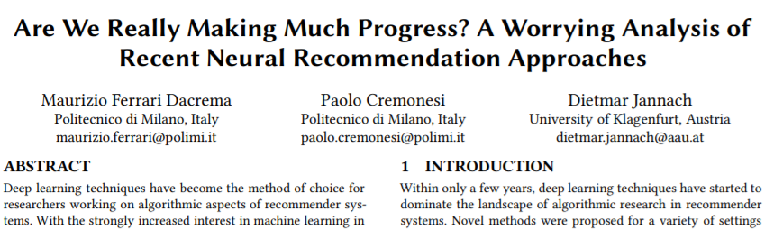

RecSys 2019 Best Paper
https://arxiv.org/pdf/1907.06902.pdf
https://www.zhihu.com/question/336304380

